Slide 1
Main Idea and Details Day 1
Learning Support
Bridge Valley Elementary

Slide 2
Lesson Objective
Identify the main idea and supporting details of paragraphs within a text and of the text as a whole

Slide 4
Important Vocabulary
Main idea- most important thought, belief, or opinion
It is the point that author is trying to make
Detail- a specific piece of information

Slide 5
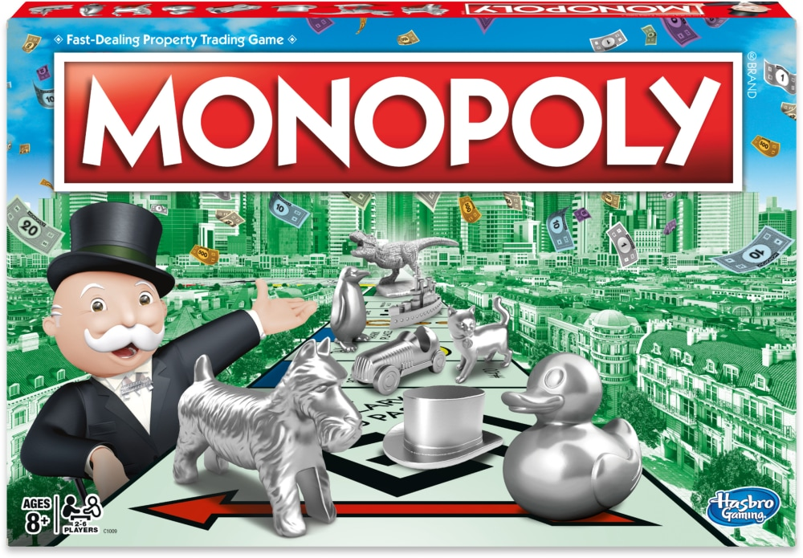
UNO is my favorite game because…
It’s easy to learn
You can play it with more than one person
It has to do with numbers

Slide 6
Topic: UNO
Main Idea: UNO is a great game to play.
Easy to learn
Play with more than one person
Has to do with numbers
Supporting Details

Slide 7
Topic: Plants
Main Idea: Plants need many things to grow
Plants need sunlight
Plants need water
Plants need soil
Supporting Details

Slide 8
Independent Practice
Think about your favorite Food and Sport
Fill out the main idea and details chart for each of your topics
Upload your work to Seesaw or TEAMS
Food
French Fries

Slide 9
Main Idea and Details Day 2
Learning Support
Bridge Valley Elementary

Slide 10
Lesson Objective
Identify the main idea and supporting details of paragraphs within a text and of the text as a whole

Slide 11
Model Passage

Slide 12
Independent Practice
Locate and read the passage “Visiting the Statue of Liberty”
Identify the main idea and two details from each paragraph in the passage and fill out the chart
Upload your work to Seesaw or TEAMS

